Slide 1
Vector Representations

Slide 2
Lesson 7
Vector Representations
Time: 120 Minutes

Slide 3
Overview
This lesson is about representing text as vectors
We will learn why we convert text to vectors
We will learn how to convert text to vectors
We will learn to use text vectors
At the end – we should be closer to understanding natural language processing

Slide 4
Lesson Objectives
By the end of this lesson, you will be able to:
Learn why text needs to be represented as vectors for natural language processing
Understand the various ways that text can be represented as vectors
Understand Word Vectors and the various forms
Learn how to create document vectors
Learn text arithmetic – e.g. King – Man + Woman = Queen

Slide 5
Why Vector Representations
Text
Vectors
Machine Learning
Text is unstructured and messy – vectors are structured
Key patterns in language can be captured using vector
Algorithms work well on mathematical representations

Slide 6


Natural Language Understanding
Discussion
Discuss ways in which human language is messy and or ambiguous and would be difficult for computer algorithms to understand?
Understand Speech
Understand text
Notes:
Possible answer
Data modeling could be done either to perform data prediction or to understand data in order to find patterns. Moreover, both approaches are used to make an informed decision.

Slide 7
Definitions
Time: 15 Minutes

Slide 8
Vector Definitions
Vector
A row or column of numbers
1 dimension
Matrix
A rectangular array of numbers
2 dimensions
Tensor
Generalization of a matrix
Arbitrary dimensions

Slide 9
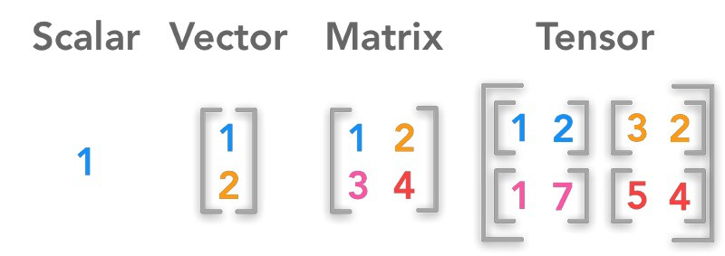
Vectors, Scalars and Matrixes
Scalars are numbers
Vectors are a row or column of numbers
A Matrix is 2 dimensional array of numbers
A tensor contains any arbitrary dimensions
Notes:
Possible answer
Discuss other technologies, such as:
Tensorflow, is an open-source machine learning library written in Python. Its main characteristics are its flexibility and velocity to compile. However, due to its flexibility requires a further level of knowledge in programming and in the math behind the algorithms.
Keras, is also an open-source machine learning library written in Python. It works on top of TensorFlow or Theano. Was designed to enable fast experimentation. Requires students to have a basic understanding of Theano and to have the disposition to tinker with Kera’s source code to achieve flexibility.

Slide 10
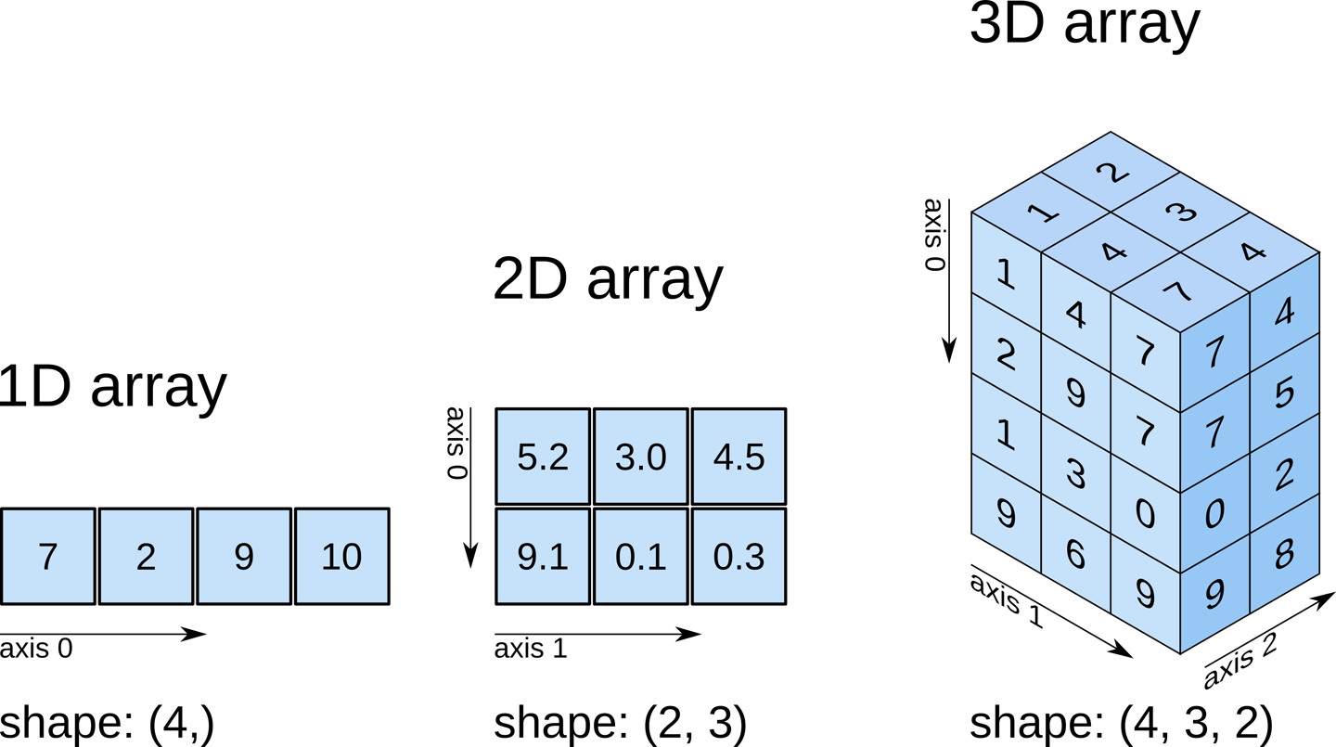
Numpy Arrays
Used in machine learning and scientific computing
Can represent a scalar, a vector, or a matrix
Contains the numerical representation of text
This lesson speaks of vectors but we will implement as numpy arrays

Slide 11

3Blue1Brown

Slide 12
Simple Text Encoding Methods
Time: 15 Minutes

Slide 13
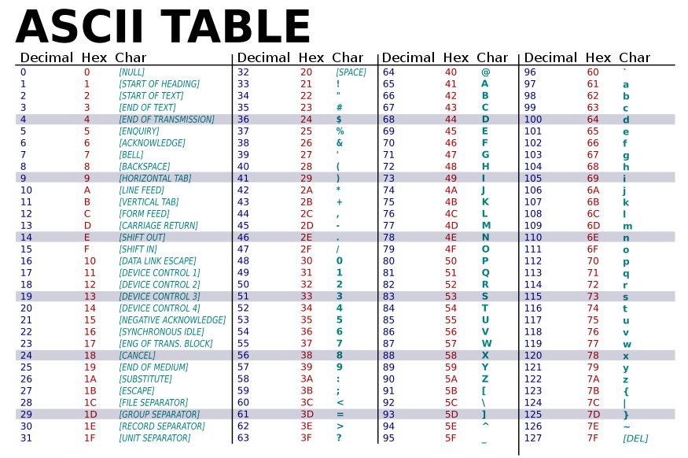
Simple Text Encoding
Map characters to Unicode or Ascii value
Simplest encoding method
Suffers scale issues e.g. Algorithms assume that A < B < C

Slide 14
Positional Encoding

Slide 15
One Hot Encoding

Slide 16
One-Hot Encoding
A type of categorical encoding
Data must be discrete categories e.g. Audi, Toyota, Mazda
One-Hot vector has length N – the number of categories
Zeros everywhere except to represent the current category
 |  |  | Apple | Orange | Broccoli
Apple |  |  | 1 | 0 | 0
Orange |  | → | 0 | 1 | 0
Broccoli |  |  | 0 | 0 | 1

Slide 17
One-Hot Encoding
Advantages
Straightforward to implement and easy for Machine Learning Algorithms to process
Certain operations are extremely fast e.g. Apple != Orange
Automatically Scales Values between 0 and 1
Disadvantages
Uses lots of memory to represent a word or character
One-Hot vectors are sparse and high dimensional
Does not encode correlation among values

Slide 18
One Hot Encoding in Different Libraries
Library | On-Hot Encoding Method
Keras | keras.preprocessing.text.one_hot keras.utils.to_categorical keras.preprocessing.text.Tokenizer.text_to_matrix
Scikit-Learn | sklearn.preprocessing.OneHotEncoder
Tensorflow | tf.one_hot
pandas | pandas.get_dummies

Slide 19
Word Embeddings

Slide 20
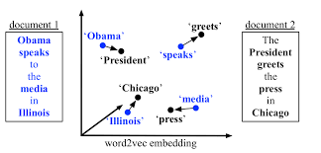
Word Embeddings
Learns which words tend to occur together
Trained on many examples of sentences and documents
An embedding is like a location coordinate
i.e. Chicago is close in meaning to Illinois, Obama close in meaning to president

Slide 21
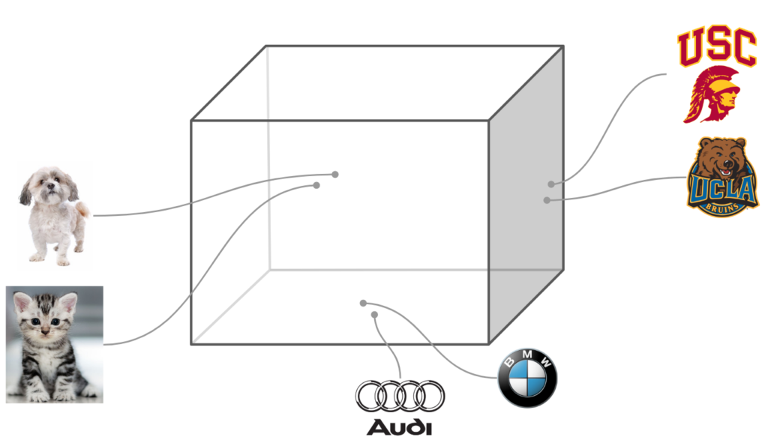
Words Embedded in N Dimensions
Discussion
Discuss how we can take a complete vocabulary of words and embed them into an N-dimensional space by their meaning.
Explain why certain words are close together in that N-dimension space

Slide 22
T

Slide 23
Word2Vec
Algorithm to learn word embeddings by predicting missing words in sentences
Developed at Google and implemented inside Tensorflow
Download pretrained word vectors for Machine Learning

Slide 24
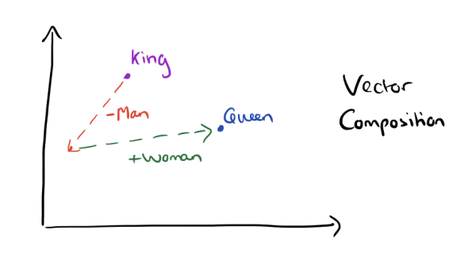
Word Vector Math

Slide 25
Text Similarity With Vectors

Slide 26
Summary

Slide 27
Review Questions

Slide 28
Data Preprocessing
Time: 30 Minutes

Slide 29
Practice Questions
Who do you think would be the preferred users of scikit-learn?
The package collaborator and experts
Beginners to the field of machine learning
Large companies mostly
Everyone in the field of machine learning
The uniformity of the API refers to the consensus among the different collaborators.
True
False
Notes:
1. b) Beginners to the field of machine learning.
2. b) False

